Slide 1
Maryland AI Community of Practice
(MDAI)
09/04/2026

Slide 2
Agenda
Welcome and Introduction to the AI CoP (Lauren Maffeo, DoIT)
Google Analytics Chat App (Suran De Silva, DoIT and Ray Bell, DoIT)
Building An AI Voice Agent (Helen Liang, MDoD)
What’s Next (Lauren Maffeo, DoIT)

Slide 3
CoP Etiquette
Mics on mute to prevent background noise
Only the speaker should have their camera on to avoid visual distractions
Add your questions to the comments or Q&A section of our chat
The team will try to address questions in the chat asynchronously
Forward this meeting to peers who might be interested (click this form)
Bring an owner’s mindset & participate

Slide 4
MDAI’s Vision and Values
The State of Maryland responsibly, ethically, and productively leverages AI/ML technologies to significantly improve constituent outcomes and reduce drudgery for the State workforce.

Slide 5
MDAI’s Values
Collaborate across teams
Show, don’t tell
Provide AI updates in a shared space

Slide 6
Google Analytics Chat App
Suran De Silva, DoIT and Ray Bell, DoIT

Slide 7
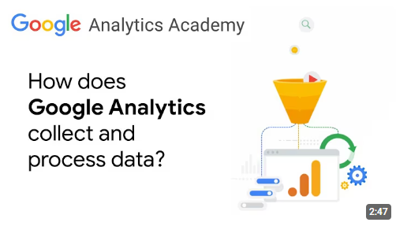
What is Google Analytics (GA)?
Captures web metrics
https://www.youtube.com/watch?v=-1e5CS_v0vY
Runs behind the scenes on Maryland agency websites to capture user behavior data on website traffic and they interact with pages.
Used to improve the customer experience
We use these behavioral insights to understand our audience's needs, streamline their journey, and build a better, more user-friendly experience.

Slide 8
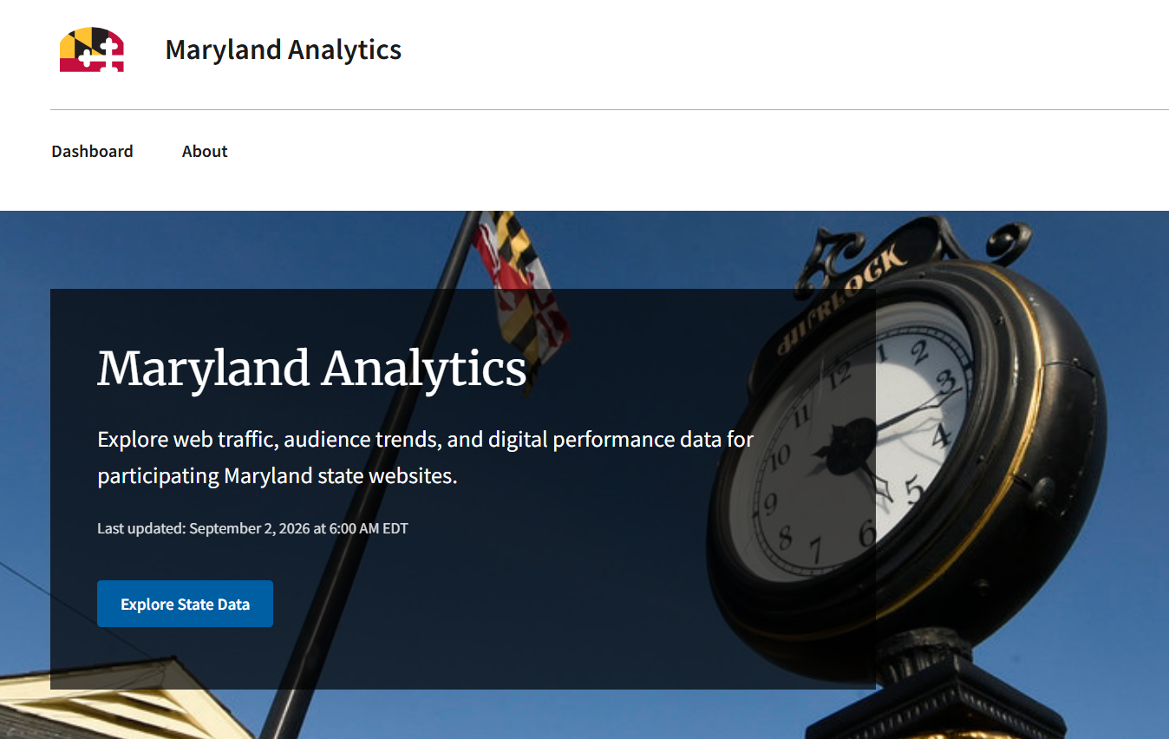
Analytics.Maryland.gov
https://analytics.maryland.gov
Standardized dashboards
Instant access to agency metrics with pre-configured charts and reports built specifically for state agency needs and KPI tracking. Gives agency leaders and web managers the data they need to make decisions on website redesigns, content updates, or resource allocation.

Slide 9



Empowering web leads
Simplified access to data
Eliminates technical gap
Accelerates decision making
Makes it easy to query specific metrics that may not be available on standard analytics.maryland.gov dashboards.
Reduces training requirements for staff who have GA access but struggle with constructing custom GA4 explorations.
Allows agency staff to ask plain-language questions and receive instant, actionable insights to inform day-to-day choices.
Notes:
Cybersecurity tool (drop in page views may denote an issue)
Plain language tool (asses web page content)

Slide 10
How you can use Google Analytics?
Google Analytics Console (analytics.google.com)
Build a dashboard (Data Studio, Power BI, analytics.maryland.gov, etc.)
Build reports using the SDK (Java, Python, .NET, REST)
Use the MCP (Model Context Protocol)
Most agencies use none(!), 1. and/or 2.
The Google Analytics Chat App uses 4. (3. under the hood)

Slide 11
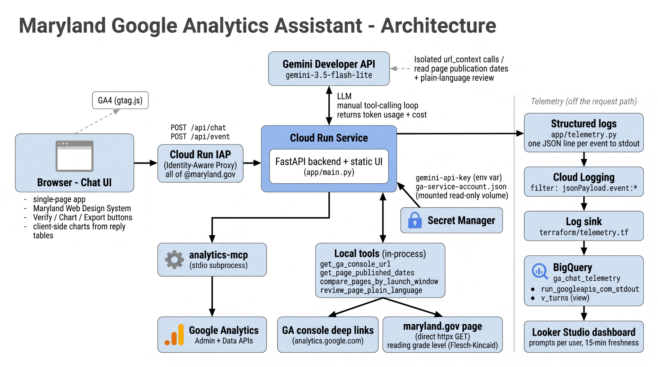
Image created using nano banana

Slide 12
Google Analytics Chat App Cost Tracking
Built using Claude Code and Antigravity CLI
Powered by Gemini 3.5 Flash Lite: cheap and fast
Gemini API costs: $10 - $50 / month
Other Google Cloud Platform (GCP) costs: < $5 / month
AI Innovation Lab request from MDDS
MDDS Procured via SOW for DoIT GCP Enterprise Agreement
No chargeback for agencies. Maryland Digital Service (MDDS) is covering costs and encouraging usage to help agencies make data-driven decisions to improve website content

Slide 13
Testimonials
“This tool was such an unlock for our agency partners. It made previously opaque analytics data open to a much wider audience and is helping individual programs make better, data-informed decisions on content organization and design.”
Paul Roberts, Senior Service Designer, MDDS
“The chat tool helped our team make the case for implementing data-informed decisions about content changes that we could not have otherwise due to analytics access limitations. This helped us build a stronger hypothesis that we could test with real users more quickly.”
Kit Miklik, UX Lead, MDDS

Slide 14
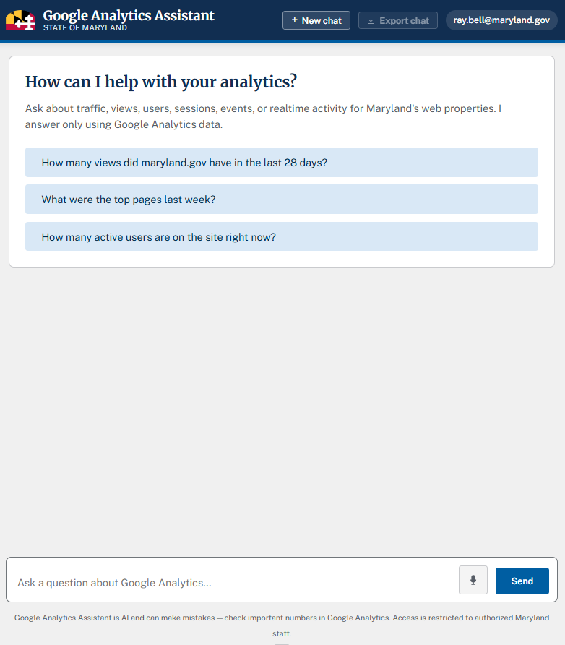
Google Analytics Chat App Demo
https://ai.maryland.gov/gachatapp
Natural language queries of Google
Analytics data to improve website
content across Maryland.gov sites
Book AI office hours to learn more,
ask questions, and get training for
Your agency’s web lead

Slide 15
Building an AI Voice Agent
Helen Liang, Maryland Department of Disabilities (MDOD)

Slide 16
The Goal: An AI Call Screener Assistant for MDOD
The ask
Use Google’s CX Agent Studio to build a front-facing chatbot for inbound calls to the front desk
Deterministic model — limited to logic flow instructed to the bot, aimed at preventing large-scale hallucinations
Answer one question — Social Security (SSA) disability benefits
Route every other caller to the front desk staff
Be accessible to callers with disabilities
Why AI?
Current operation structure: MDOD staff answer the phone, work out what each caller needs (frequently unrelated to our operations), and connect Marylanders to the right program or person
Much of that call volume is the same handful of questions, asked over and over, that MDOD can’t actually help with, and which delays constituent access to resources

Slide 17
Optimizing Efficiency without Sacrificing Customer Service
Saving staff time
Repeat SSA benefits calls get handled without pulling a staff member away from other work
Time comes back to the complex constituent cases that actually need judgment
Fewer interruptions means faster follow-up on open cases
Holding service quality
The bot answers only what it can answer confidently — everything else routes
Callers reach a person whenever they want one
Staff remain the point of contact for anything nuanced
Accessibility is a requirement, not an enhancement

Slide 18
Building Process and Infrastructure
No-code
Created using Google CX Agent Studio, part of the GCP suite of tools
Plain-language instructions able to be transformed into “code” — XML language
HTML testing
Deployable as an interactive widget with websites
Can be a voice, text, or voice and text based agent
Code automatically generated by Agent Studio
AWS Sandbox
Worked with Lauren, Michael, and DoIT team to create a sandbox for simulating the phone line
Ported GCP project into Amazon and aim to link to Amazon Connect phone number for test

Slide 19
What the Chatbot Does
Answers one question
Focused scope: SSA benefits inquiries
Consistent, accurate answer on every call
Directs constituents to regional social security offices based on zip codes
Routes everyone else
Any other question goes straight to the front desk
No dead ends — a caller who wants to talk to a person gets transferred to one

Slide 20
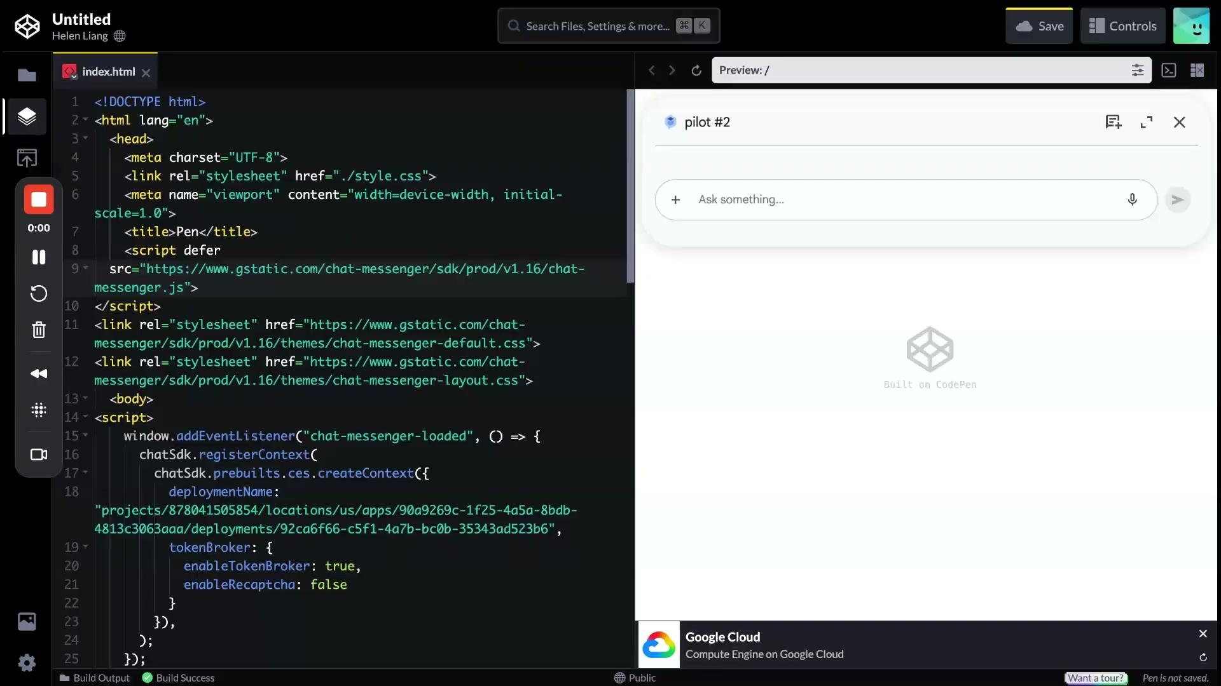
Video Demo

Slide 21
Challenges Along the Way
Bot hallucinations with dataset
Formatting instructions and language
Deployment of bot to phone line testing
State of Maryland permissions issues
Experimental nature of new platforms, lack of clear roadmap guide

Slide 22
Risks and Future Costs of Going Public
Before this moves to the public
Costs scale with traffic, not with staff time saved. Usage-based pricing with third-party agents means a public entry point could multiply session volume well past what an internal phone line generates
There is no spending cap by default: Quotas, per-session limits, and billing alerts need to be set before launch, not after the first surprise invoice
A wrong SSA benefits answer carries more exposure in public than in a pilot; keeping scope narrow, logging every interaction, and routing anything uncertain are the controls that protect us
Maintenance is a standing line item, not a one-time build — SSA guidance changes, and someone has to own reviewing and updating the answer

Slide 23
New AI Features
Lauren Maffeo, DoIT

Slide 24
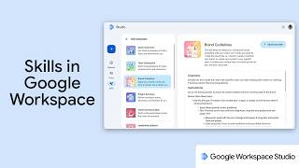
Google Workspace Skills
https://studio.workspace.google.com/skills

Slide 25
What’s Next?
We meet each 1st Friday of the month
Submit your AI use cases to our inventory
Book MDAI office hours
Email AI@maryland.gov to show your work at a future AI CoP!

